Slide 1

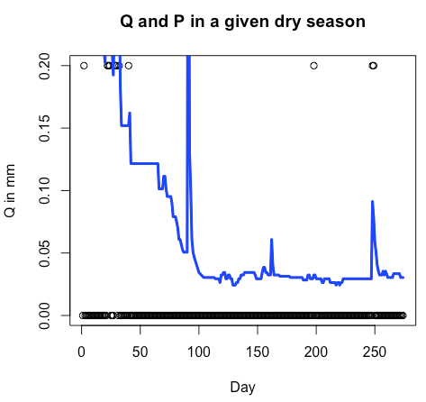
Power law recession constants (a, b) for seasonally dry
For now, “lumped” method by plotting log(Q) vs log(-dQ/dt) and finding slope and intercept. Need to do Dave’s event scale stuff?
Ignore a certain number of days after rain to allow for overland flow (how many days?)
Ignore when dQdt > 0 (i.e. increasing streamflow)
Have minimum length of recession (how many days?)
What to do with “chunky” Q records?
Need to separate recession curve for shallow vs. deep aquifer?

Slide 2
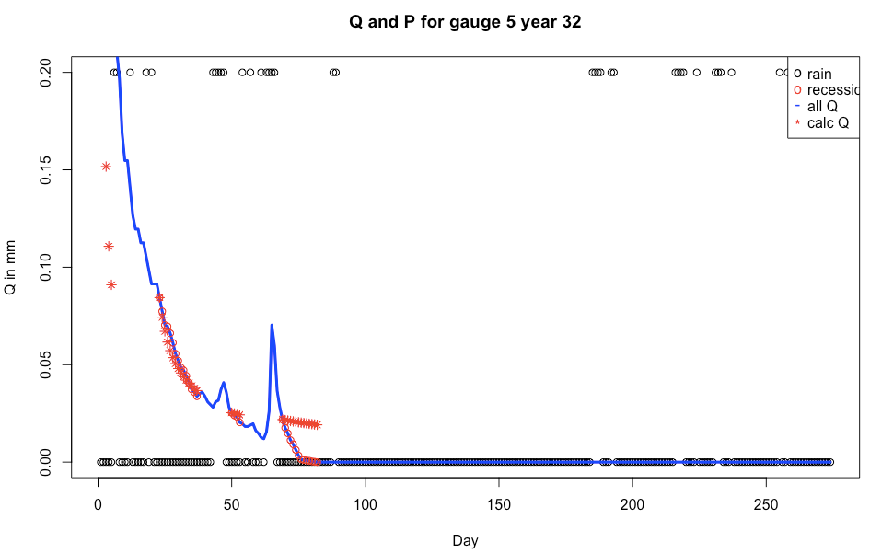
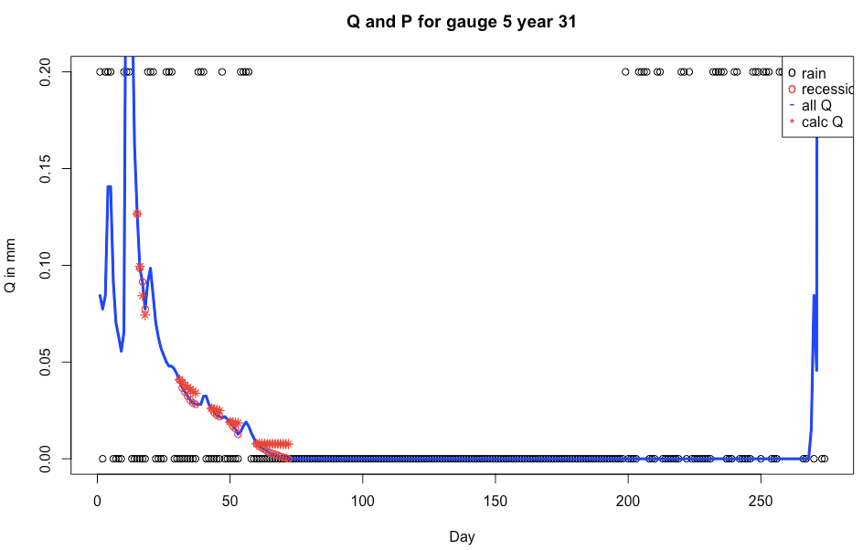
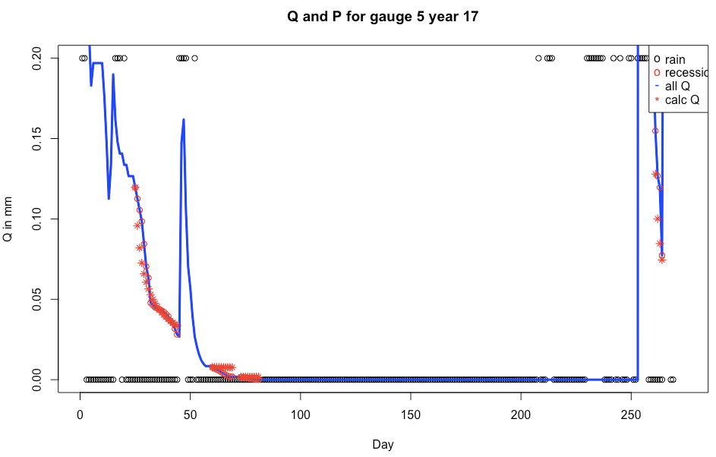
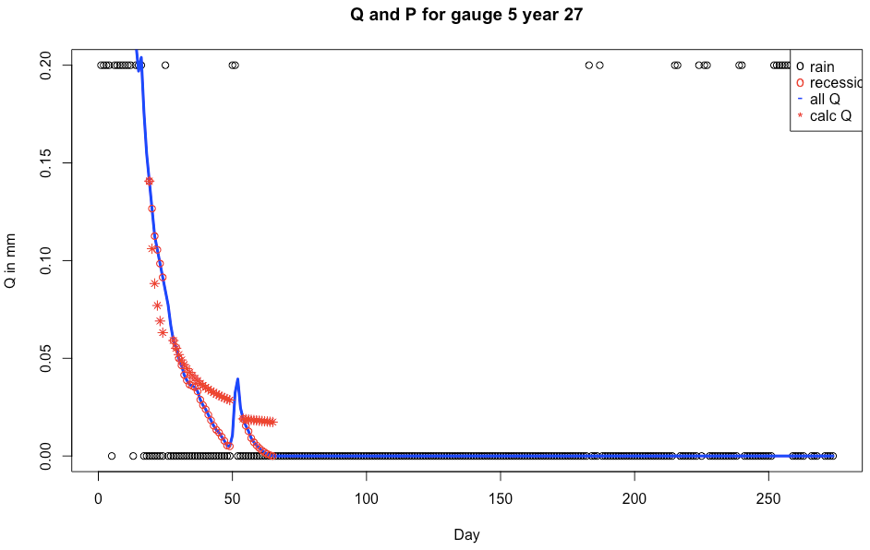
R code: Power Law Validation.R

Slide 3
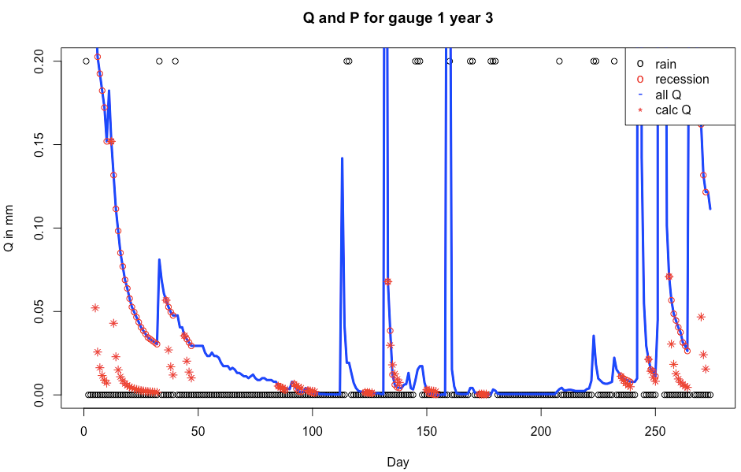
R code: Power Law Validation.R

Slide 4
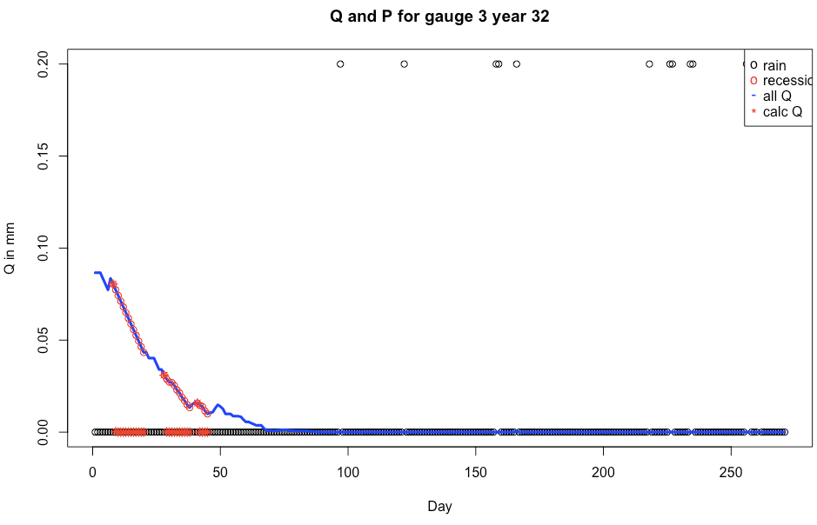
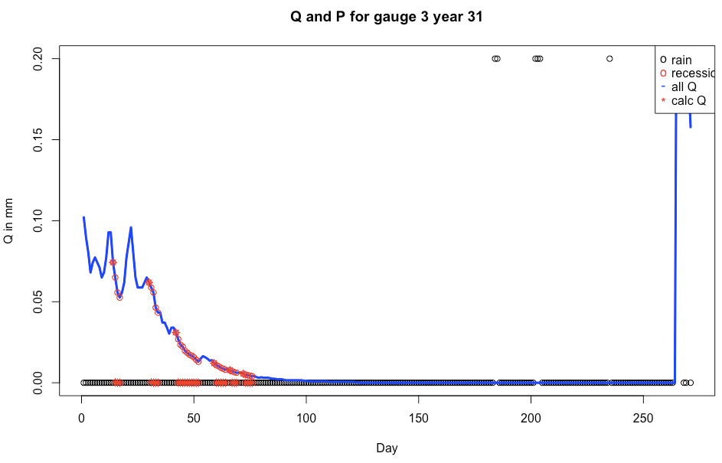
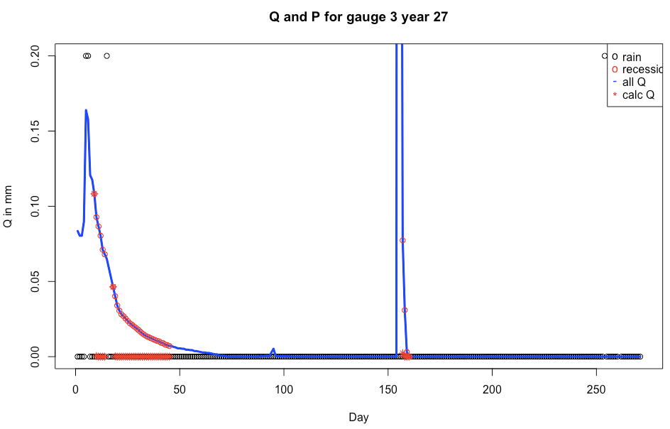
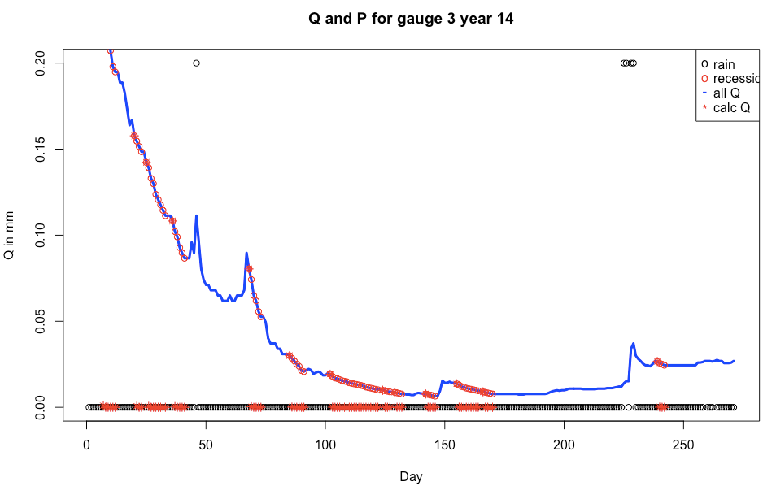
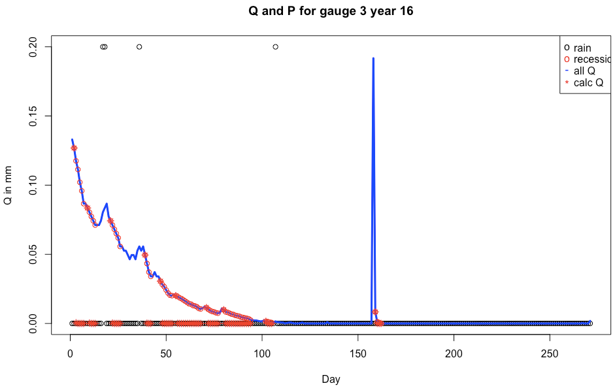
There was a Q peak even without rain…
R code: Power Law Validation.R

Slide 5
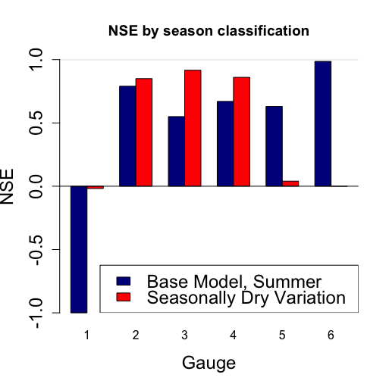
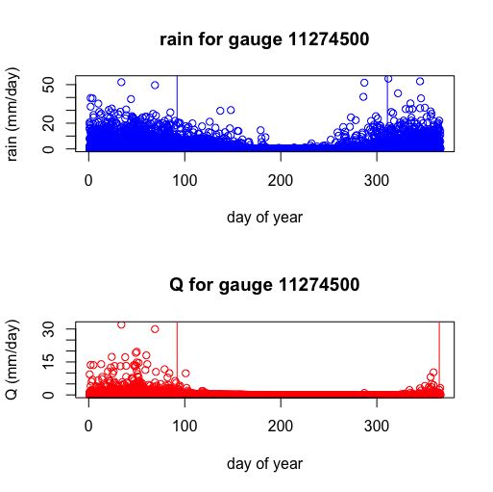
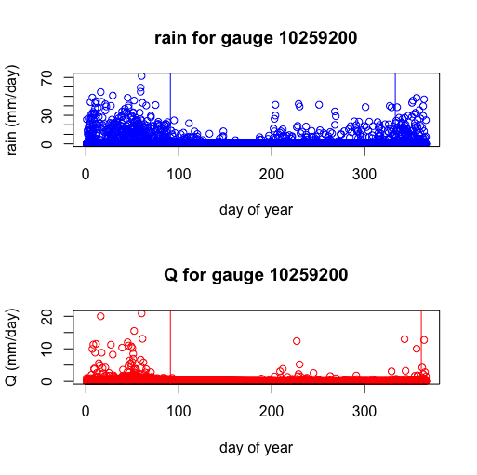
seasonally dry climates
Gauge 3
Gauge 6
Daily Precipitation
Daily Precipitation
Daily Precipitation
Daily Streamflow
Daily Streamflow
Daily Streamflow

Slide 6
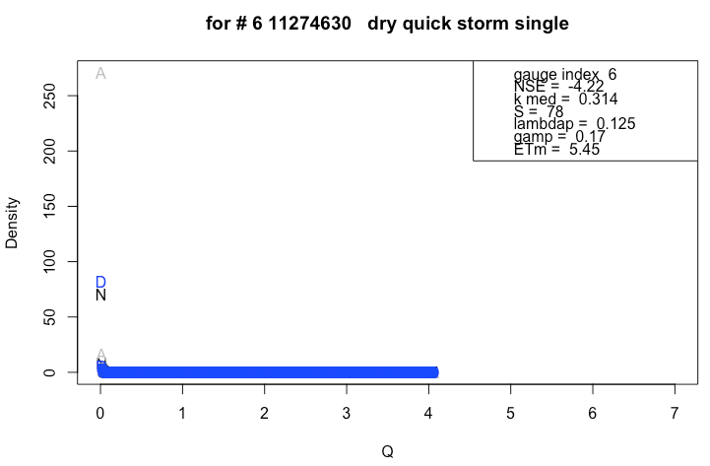
NSE is poor in this case even though pdfs look very similar… Due to the outsized effect of the left hand side? How to control for this?
N = pdf of dry season Q, solved numerically
A = pdf of dry season Q, solved using analytic equation
D = pdf from the data
All have same number of bins, bin width

Slide 7
To Do:
Code up Schaefli’s snow dominated catchments
need to calibrate z* (threshold altitude) using Q pdf… so what’s the use of this method in ungauged basin?
Read more about seasonality? (anything about classifying Mediterranean climates?)
Scheduling – qual? Paper 1?

